Slide 1
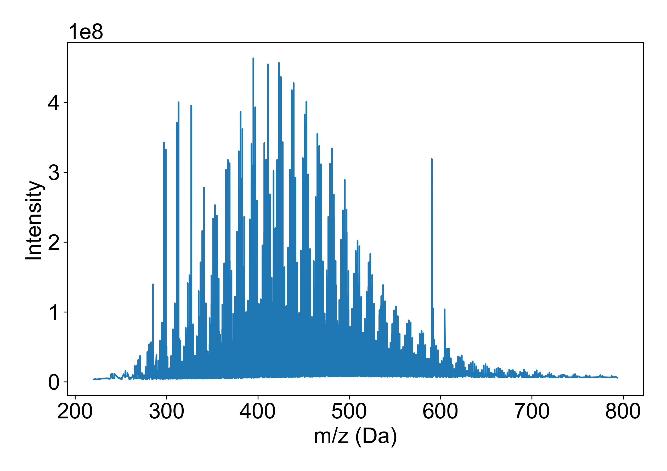
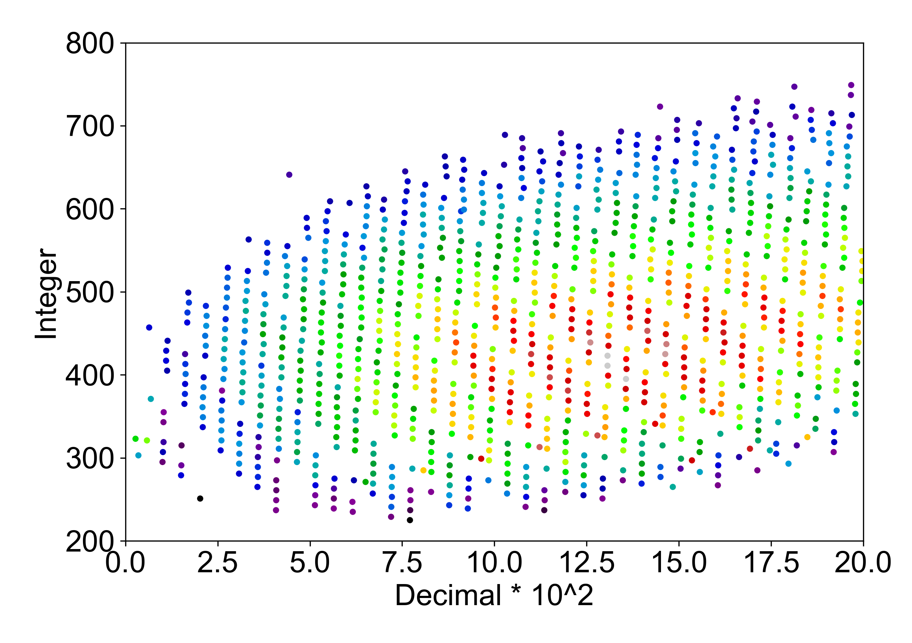
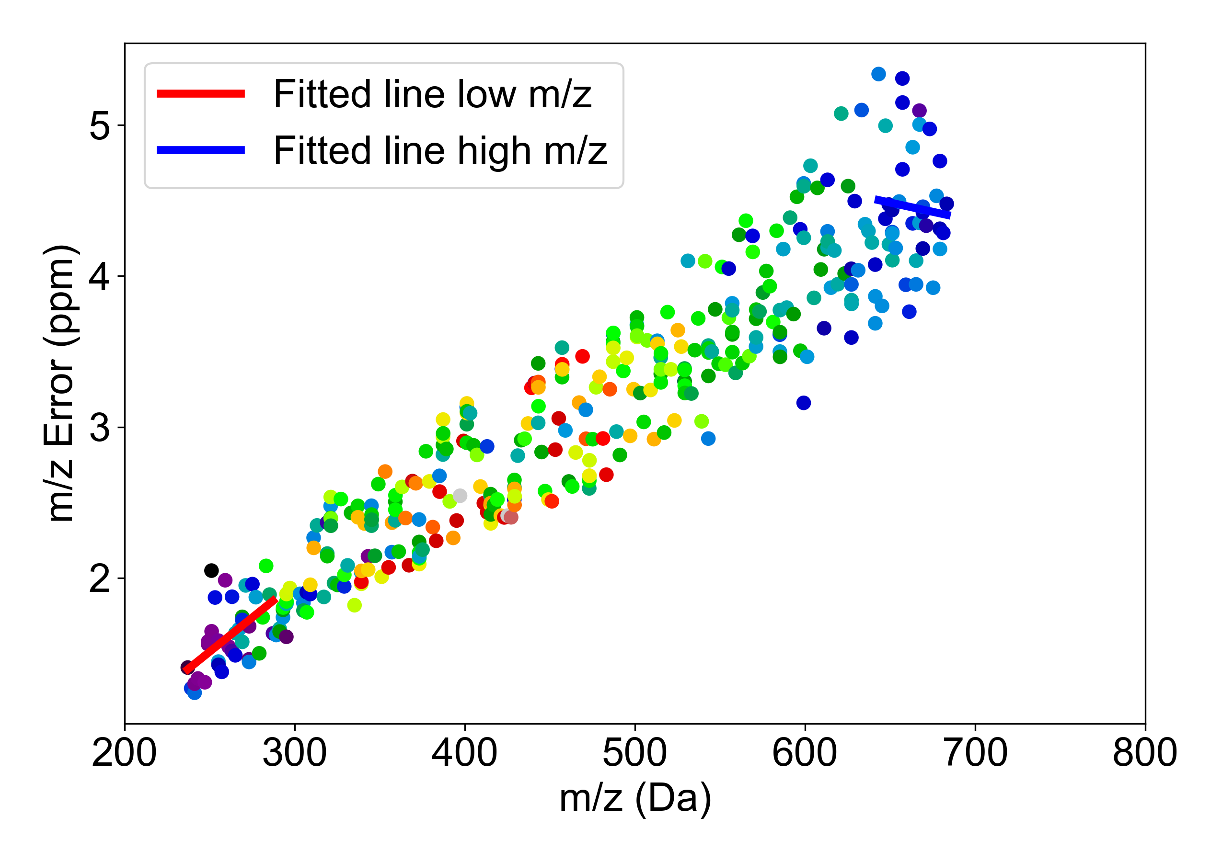
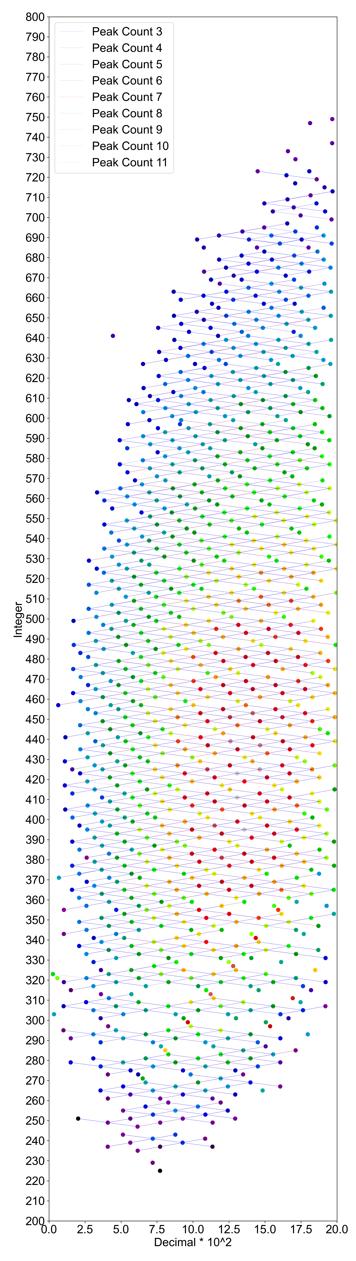
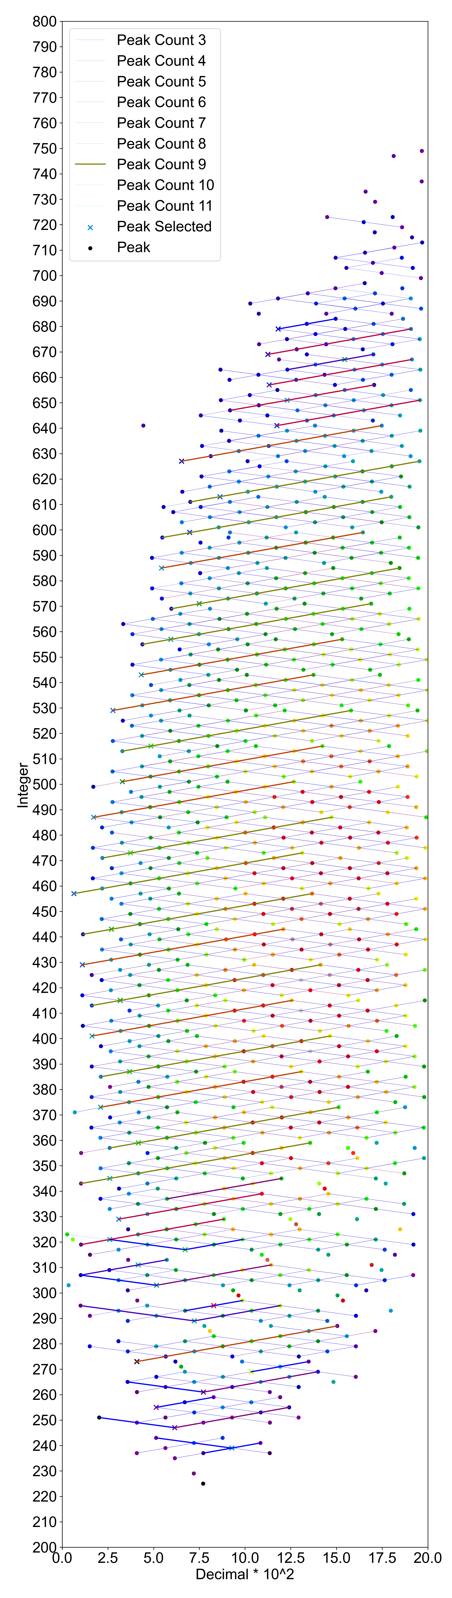
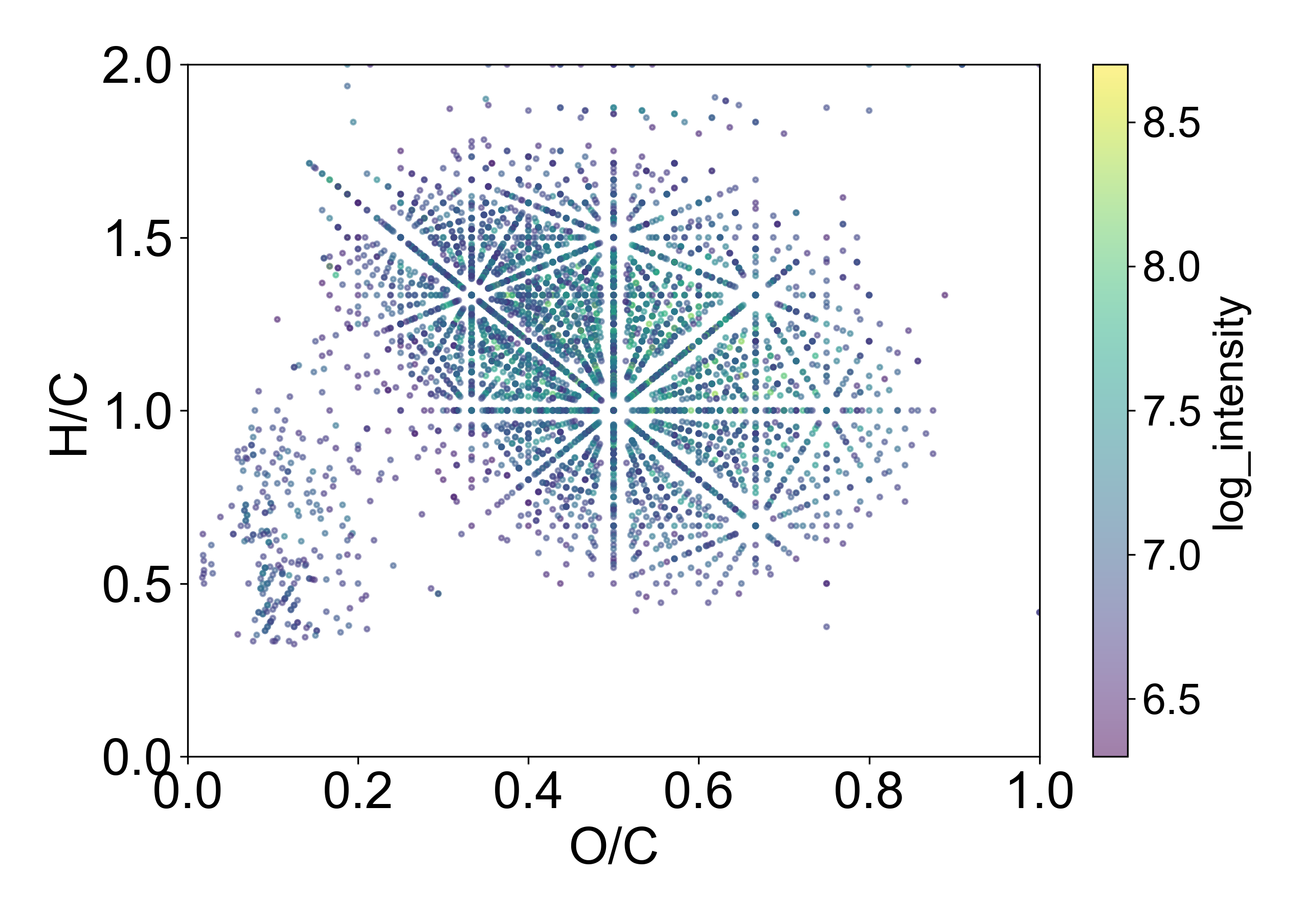
A test of the MSCMcalib method using (-) ESI FT-ICR MS spectrum of non-standard organic matter sample XX01S* collected from Xiangxi Bay in the Three Gorges Reservoir, Hubei, China as input
Figure 1. (-) ESI FT-ICR MS spectrum of XX01S
Figure 2. Integer-decimal visualization of peaks of XX01S
Figure 3. Mass error (compared to theoretical m/z) and 𝑚/𝑧 plot of FT-ICR MS spectrum of XX01S
Figure 4. Detected lines of extracted peaks on the 2D integer-decimal map of FT-ICR MS spectrum of XX01S
Figure 5. Calibration path on the 2D integer-decimal map of FT-ICR MS spectrum of XX01S
Figure 6. van Krevelen diagram of assigned peaks of FT-ICR MS spectrum of XX01S
*A detailed sample description can be found in our previous work by Pan, Q., et al., Machine-learning assisted molecular formula assignment to high-resolution mass spectrometry data of dissolved organic matter. Talanta, 2023. 259: p. 124484.

